Slide 1
Micro services-Domain Driven Design
Notes:
Add instructor notes here.

Slide 2
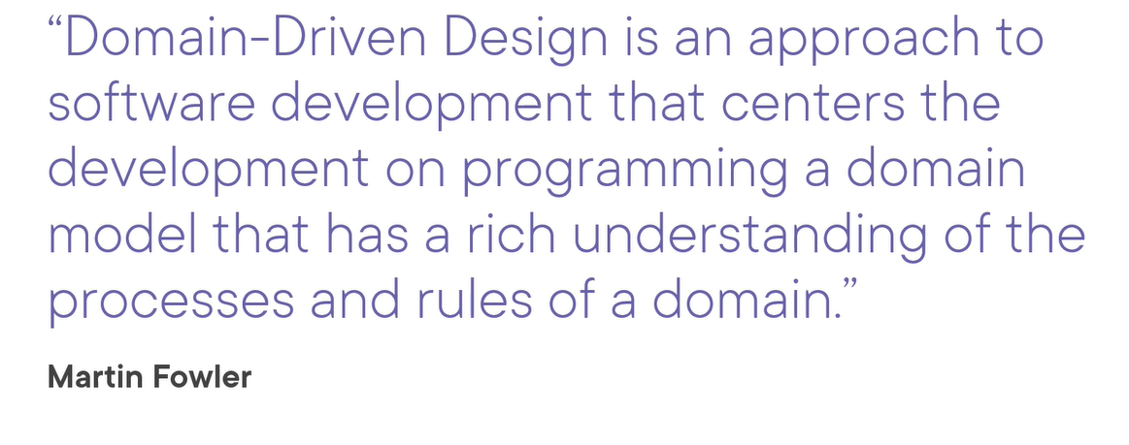
Domain Driven Design

Slide 3
Why Domain Driven Design
Domain-driven design, or DDD, is a software design methodology aimed at producing better software.
Engineers achieve this by working closely with domain experts during the continuous design process
The Design Problem
In software, there are many design problems. And, there are many tools to solve them. For one thing, we have patterns.
For another, we have models. Domain-driven design uses these tools and introduces some concepts of its own for dealing with complexity.

Slide 4
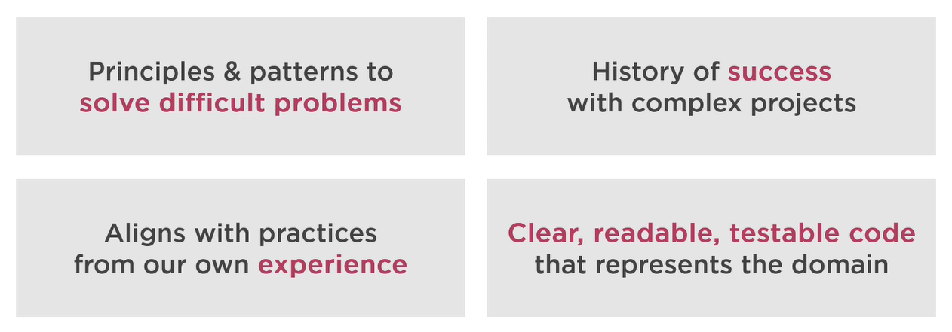
Why DDD

Slide 5
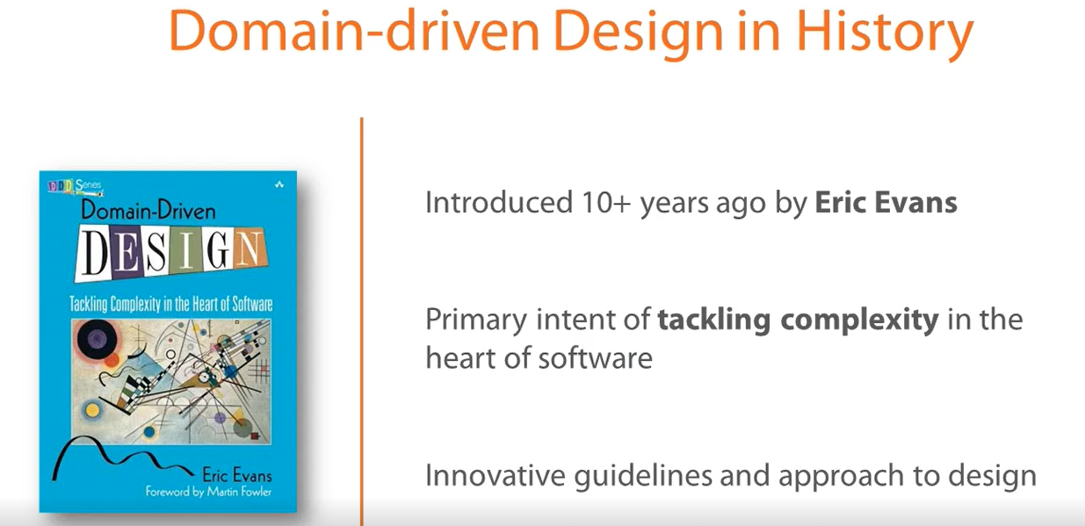
Notes:
Handle errors gracefully and return standard error codes
To eliminate confusion for API users when an error occurs, we should handle errors gracefully and return HTTP response codes that indicate what kind of error occurred. This gives maintainers of the API enough information to understand the problem that’s occurred. We don’t want errors to bring down our system, so we can leave them unhandled, which means that the API consumer has to handle them.
Common error HTTP status codes include:
400 Bad Request – This means that client-side input fails validation.
401 Unauthorized – This means the user isn’t not authorized to access a resource. It usually returns when the user isn’t authenticated.
403 Forbidden – This means the user is authenticated, but it’s not allowed to access a resource.
404 Not Found – This indicates that a resource is not found.
500 Internal server error – This is a generic server error. It probably shouldn’t be thrown explicitly.
502 Bad Gateway – This indicates an invalid response from an upstream server.
503 Service Unavailable – This indicates that something unexpected happened on server side (It can be anything like server overload, some parts of the system failed, etc.).

Slide 6
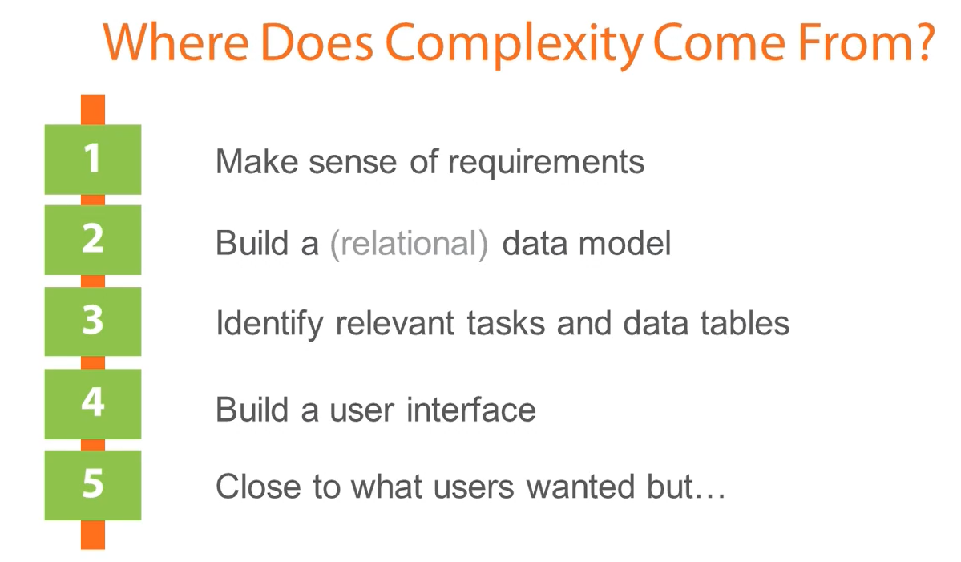
Domain Driven Design
Notes:
Use nouns instead of verbs in endpoint paths
We shouldn’t use verbs in our endpoint paths. Instead, we should use the nouns which represent the entity that the endpoint that we’re retrieving or manipulating as the pathname.

Slide 7
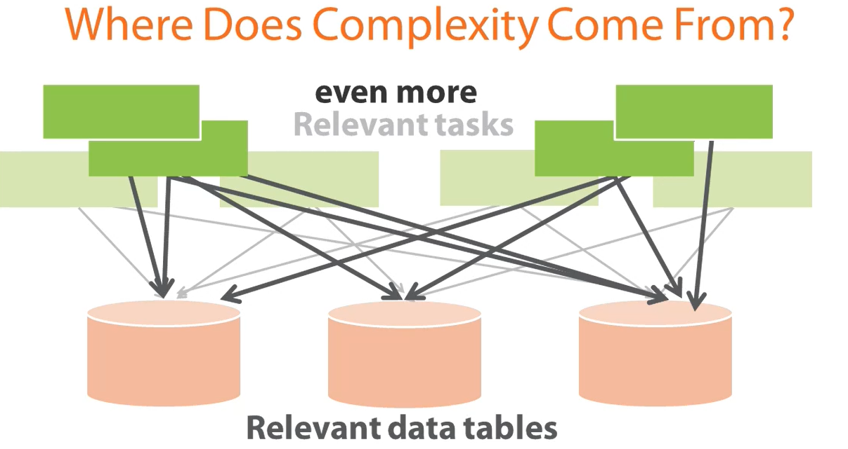
Domain Driven Design
Notes:
Lack Of Domain knowledge make software unmanageable

Slide 8
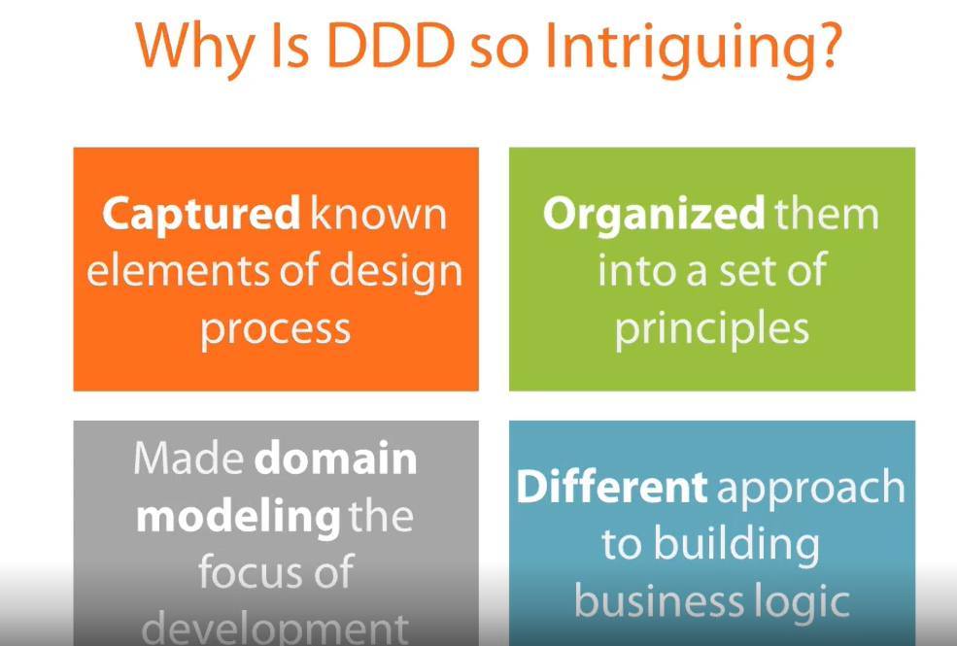
Domain Driven Design
Notes:
What is a REST API?
A REST API is an application programming interface that conforms to specific architectural constraints, like stateless communication and cacheable data. It is not a protocol or standard. While REST APIs can be accessed through a number of communication protocols, most commonly, they are called over HTTPS, so the guidelines below
Accept and respond with JSON

Slide 9
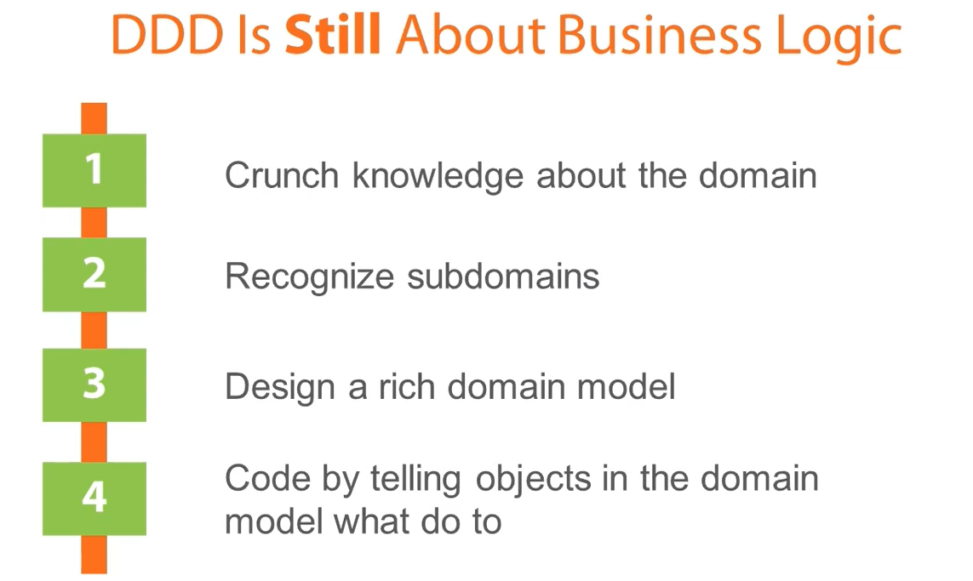
Notes:
Lack Of Domain knowledge make software unmanageable

Slide 10
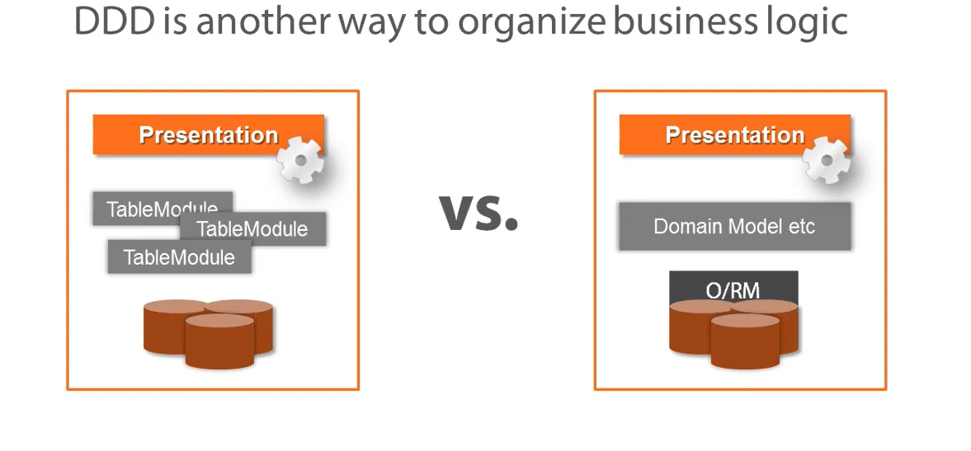
Notes:
Lack Of Domain knowledge make software unmanageable

Slide 11
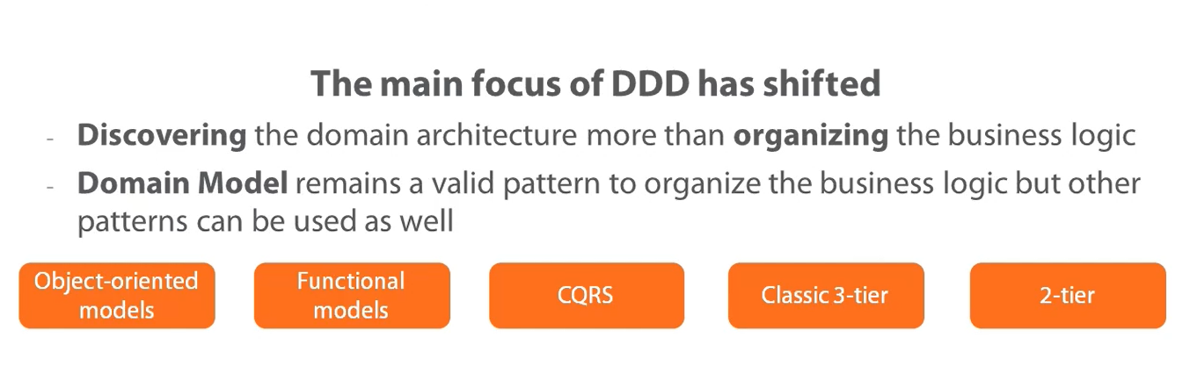

Slide 12
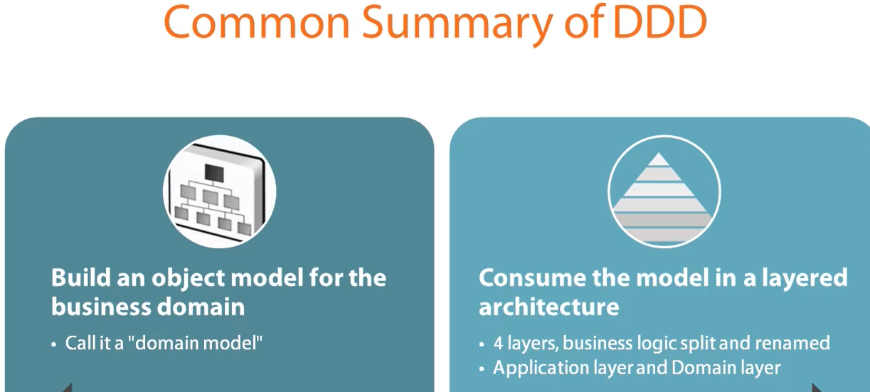
Domain Driven Design

Slide 13
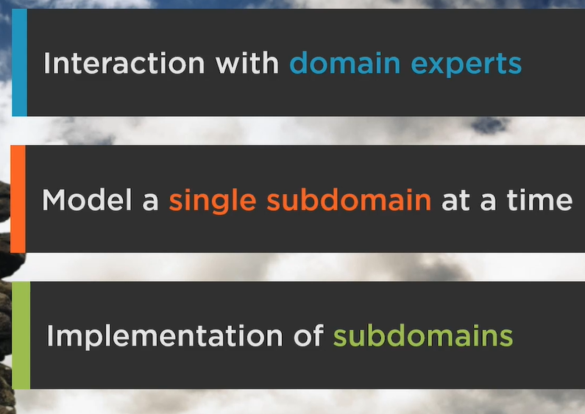
DDD principal

Slide 14
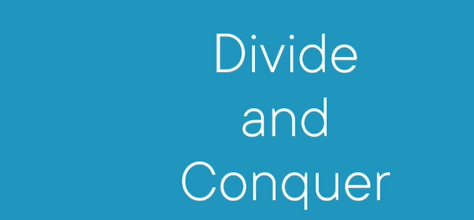
DDD Principle

Slide 15
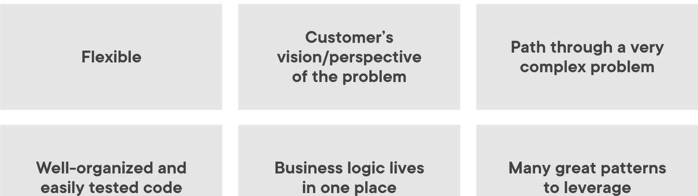
Benefits Of DDD

Slide 16
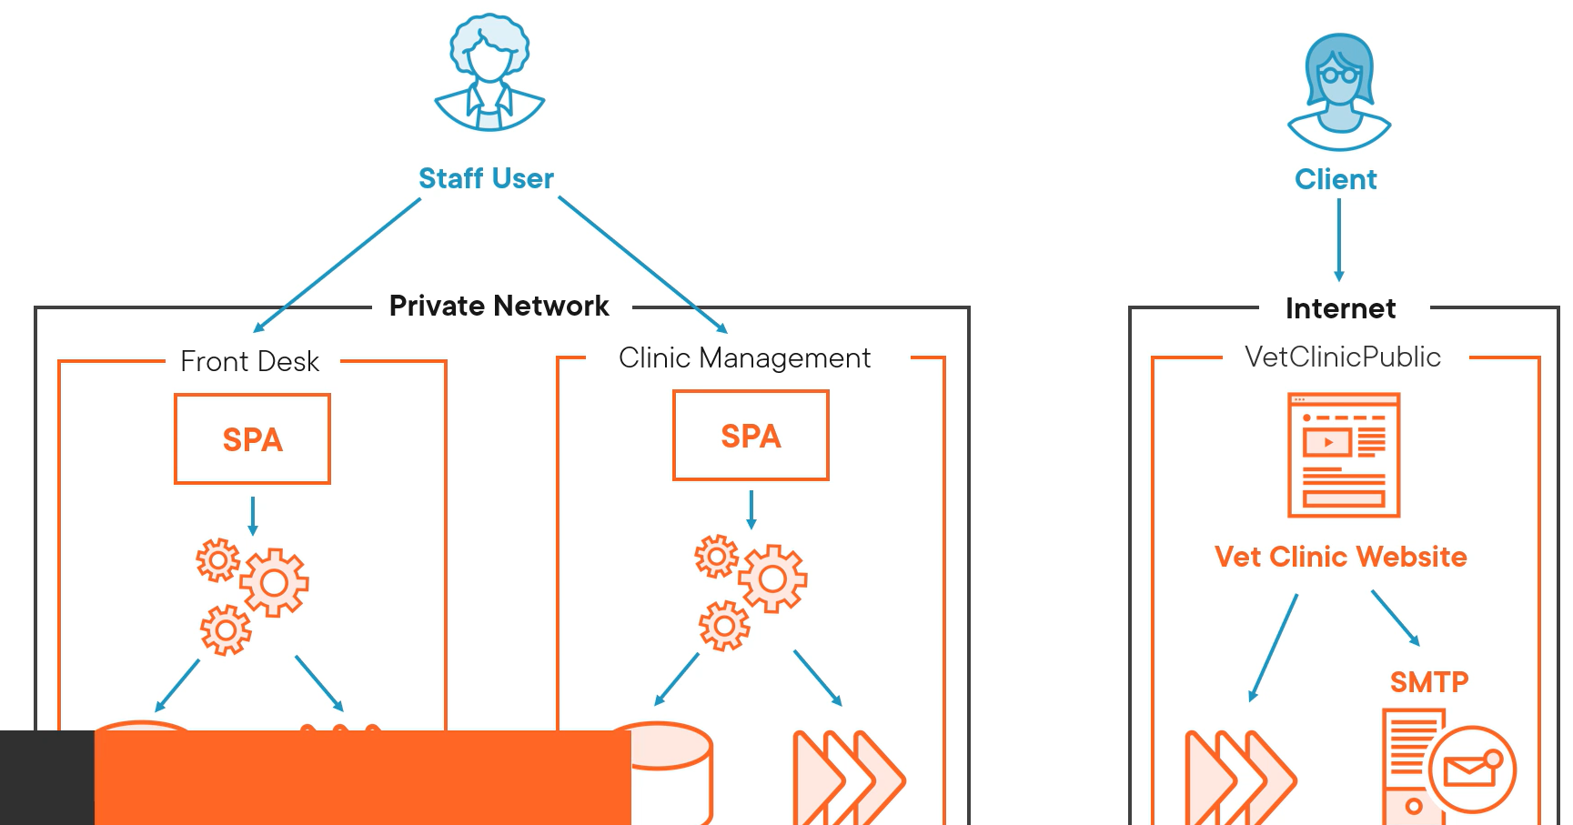
Benefits Of DDD

Slide 17
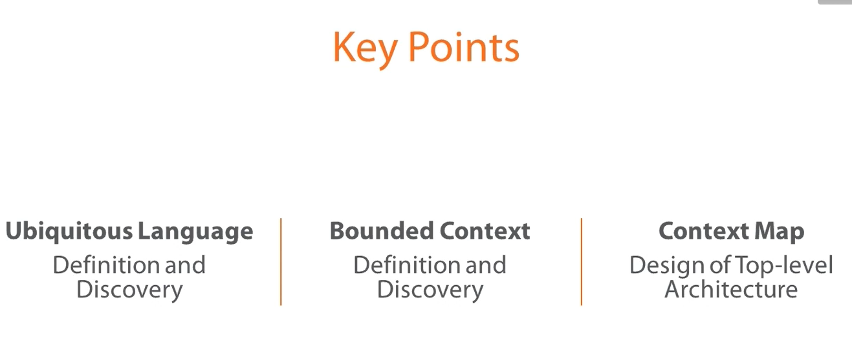
Domain Driven Design

Slide 18
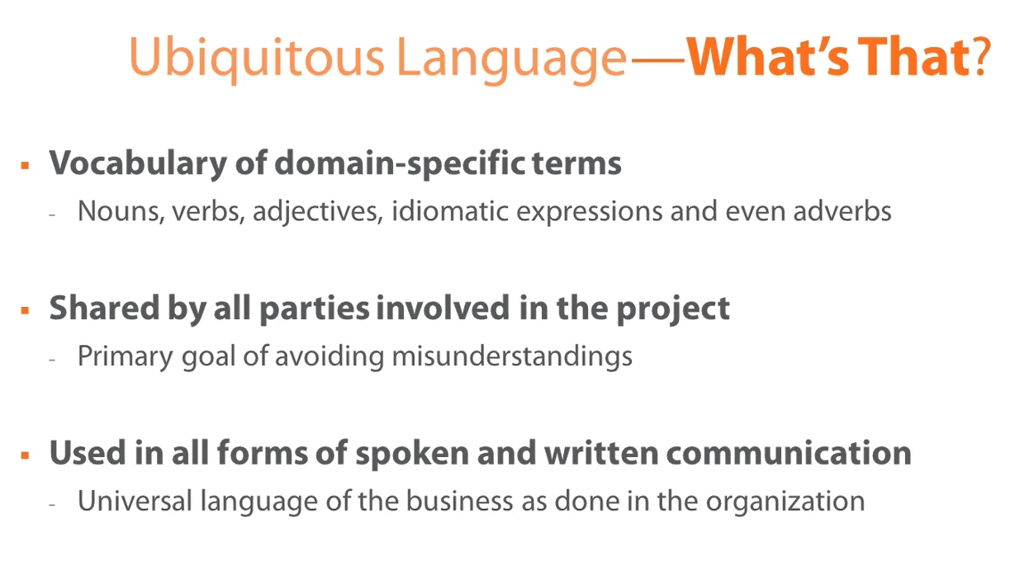
Domain Driven Design

Slide 19
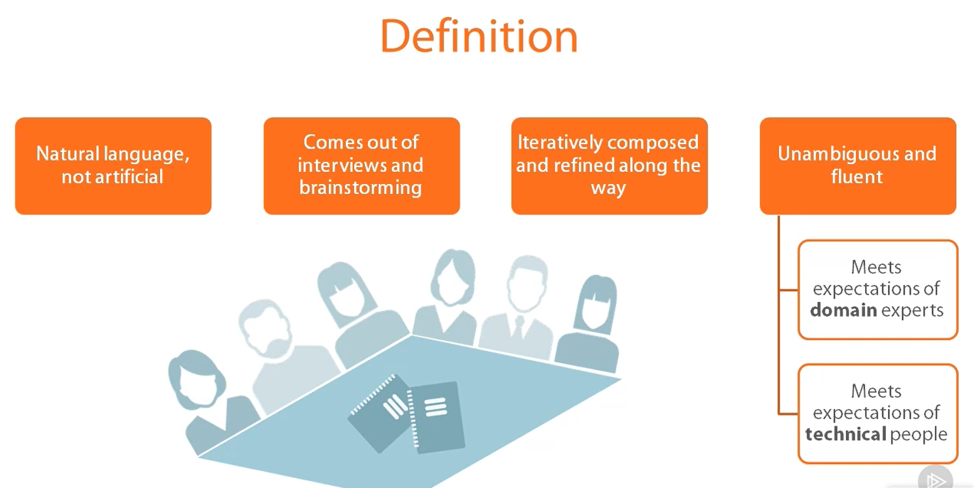
Domain Driven Design

Slide 20
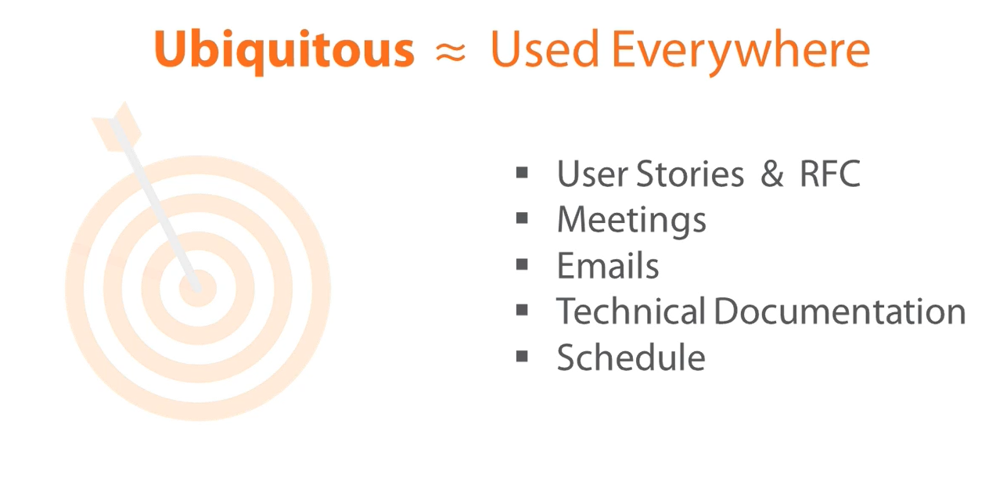
Domain Driven Design
Notes:
RFC-Request for change

Slide 21
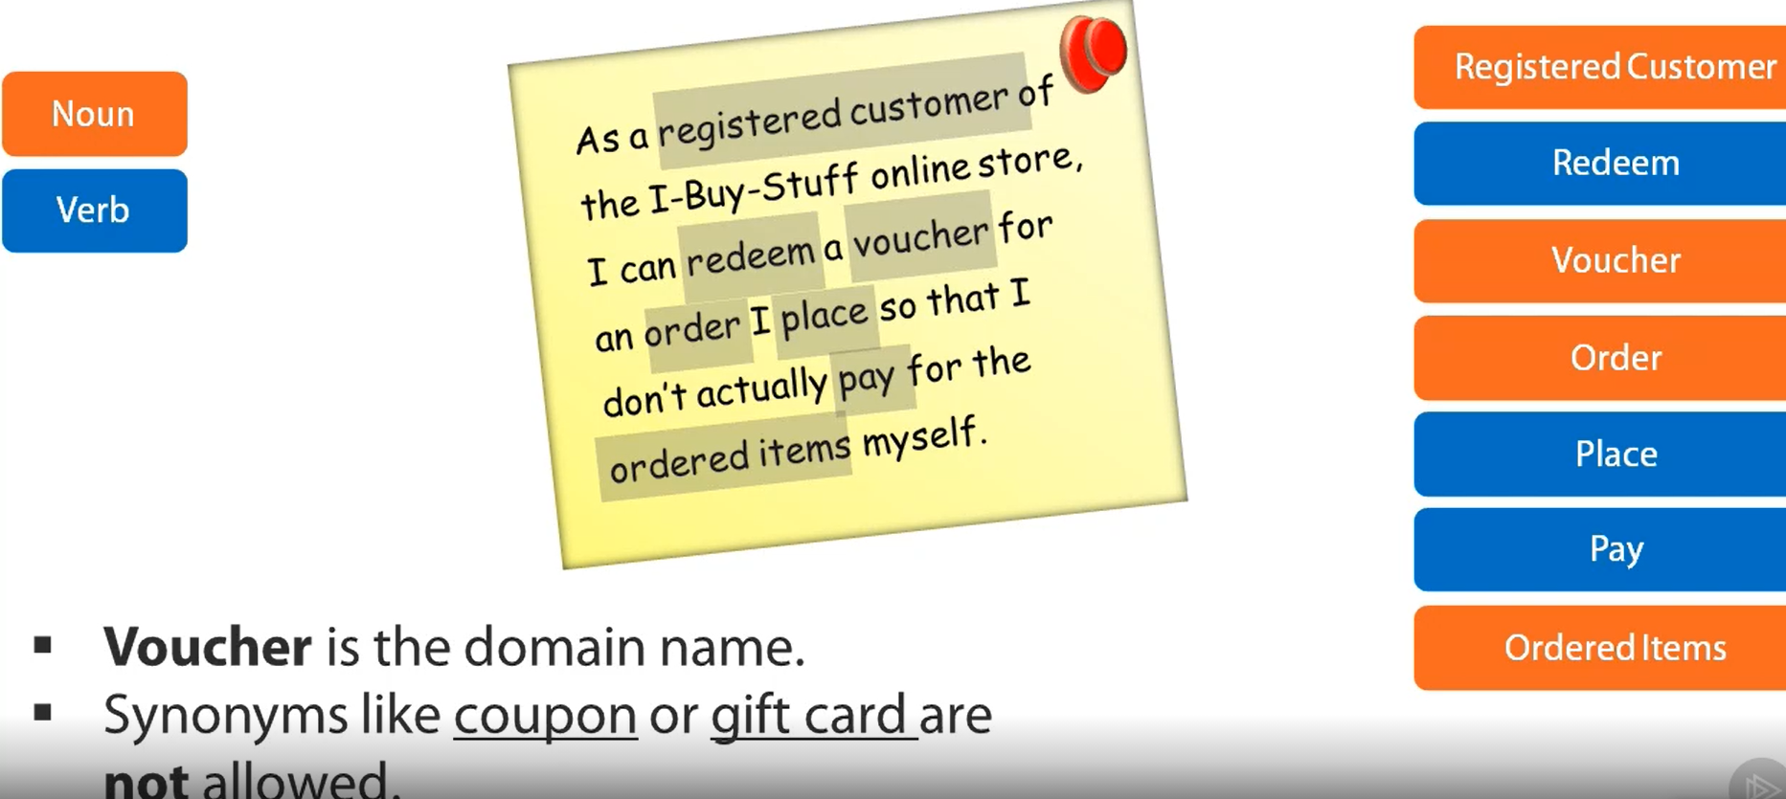
Domain Driven Design
Notes:
RFC-Request for change

Slide 22
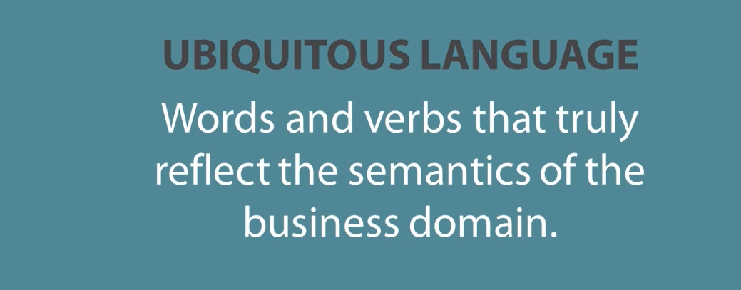
Domain Driven Design
Notes:
RFC-Request for change

Slide 23
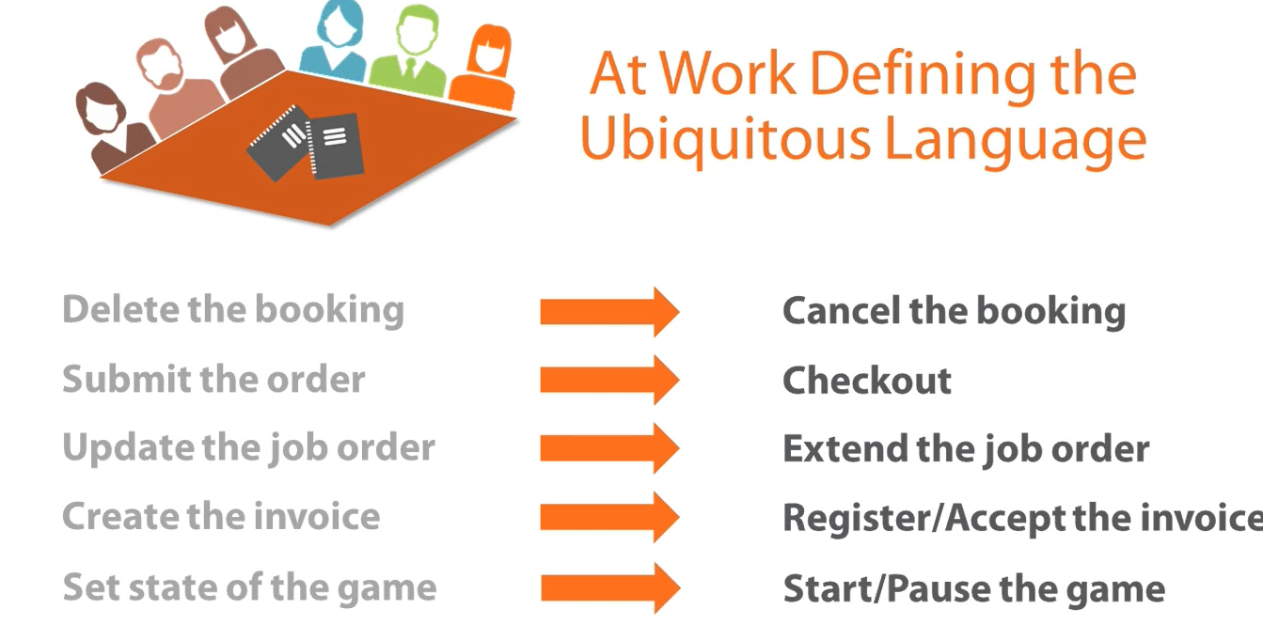
Domain Driven Design
Notes:
RFC-Request for change

Slide 24
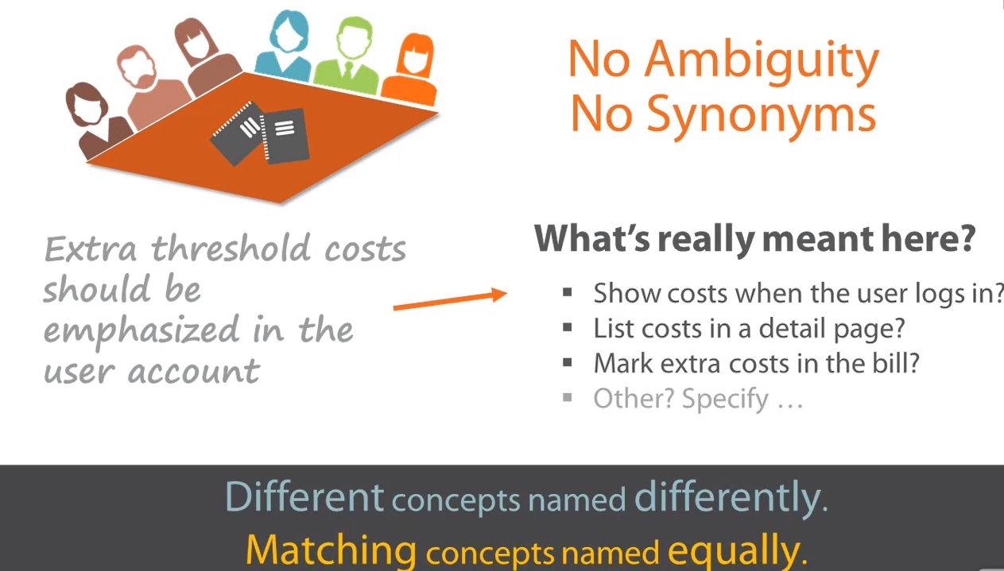
Domain Driven Design
Notes:
RFC-Request for change

Slide 25
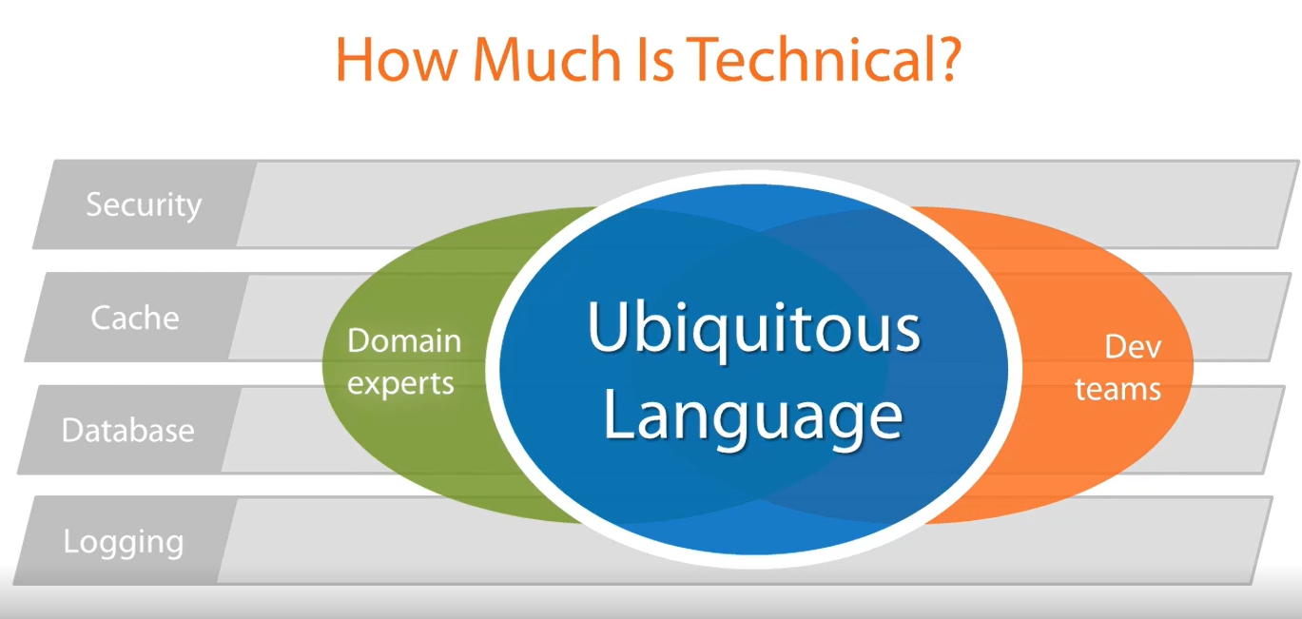
Domain Driven Design
Notes:
RFC-Request for change

Slide 26
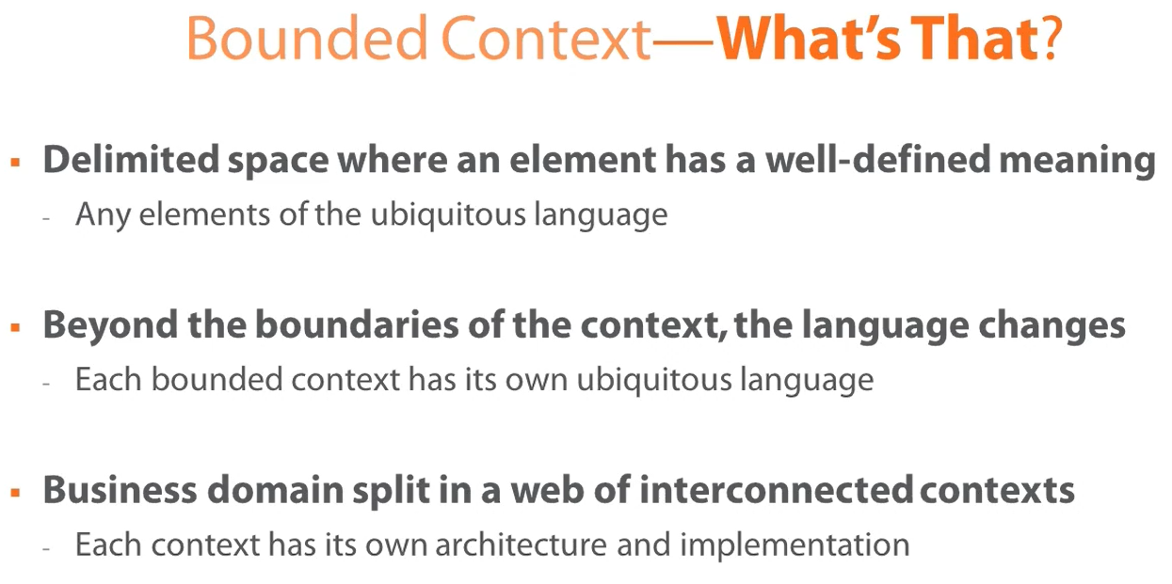
Domain Driven Design
Notes:
RFC-Request for change

Slide 27
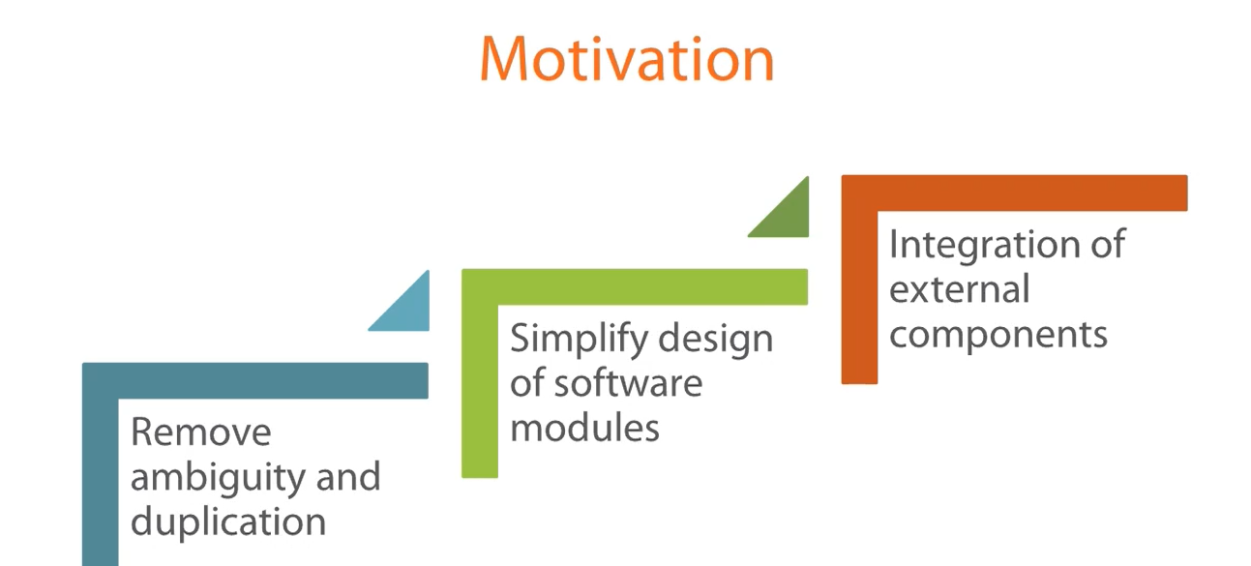
Domain Driven Design
Notes:
RFC-Request for change

Slide 28
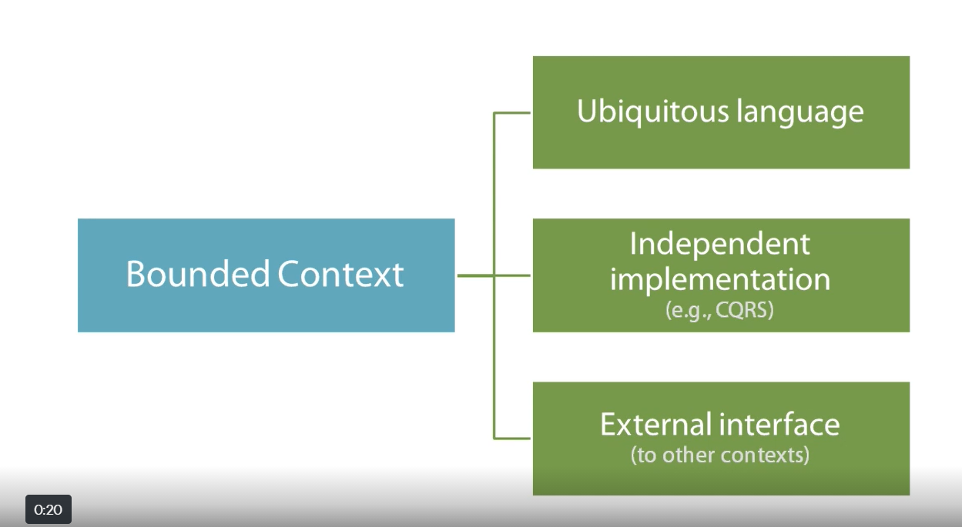
Domain Driven Design
Notes:
RFC-Request for change

Slide 29
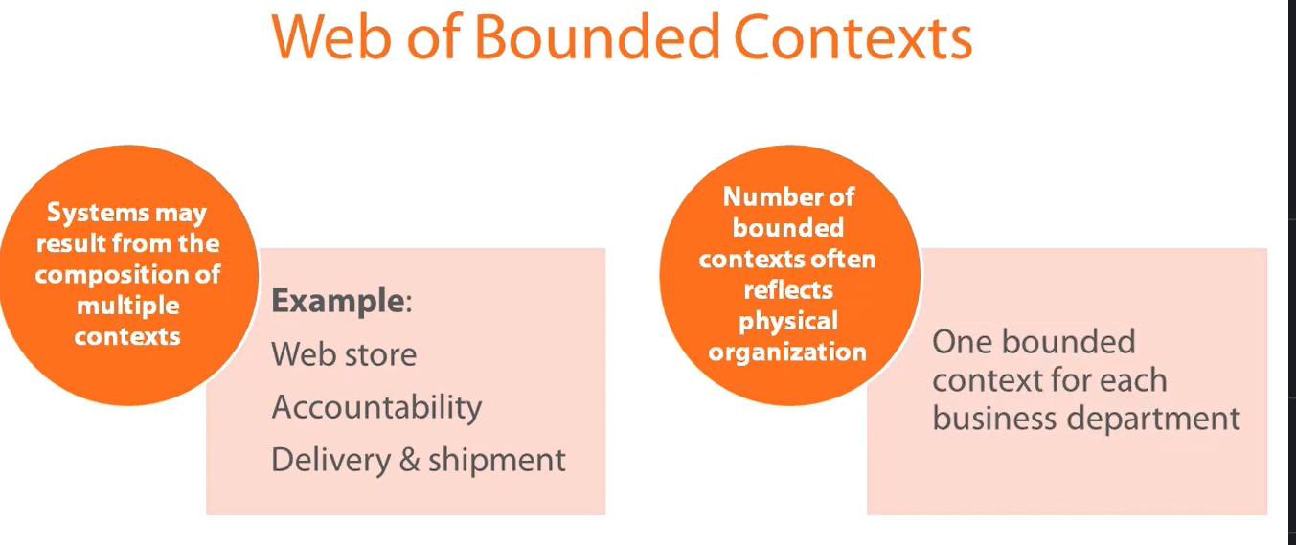
Domain Driven Design
Notes:
RFC-Request for change

Slide 30
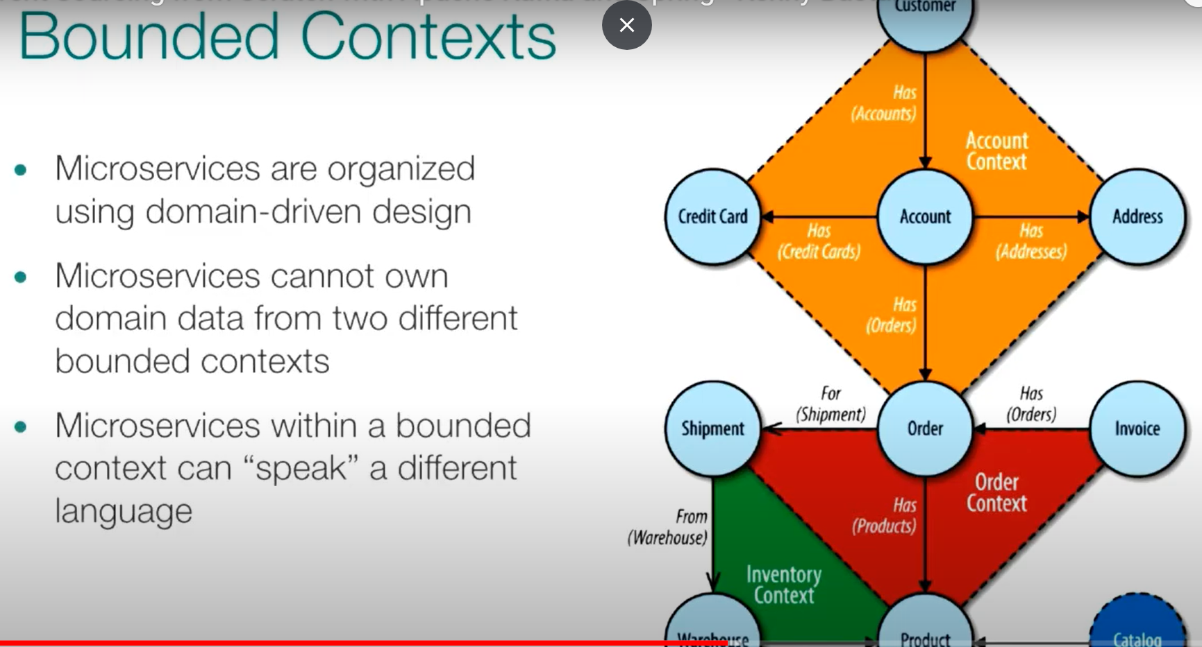
Domain Driven Design
Notes:
RFC-Request for change

Slide 31
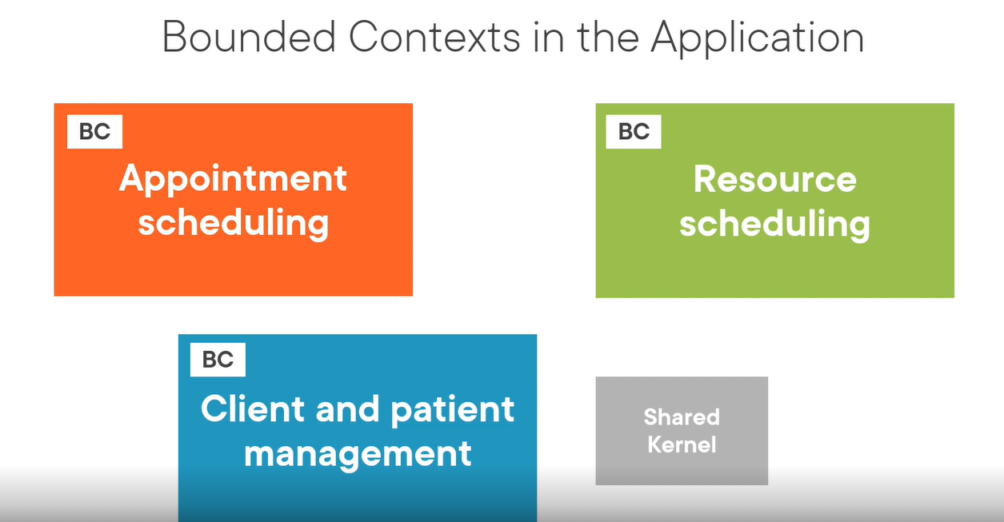
DDD

Slide 32
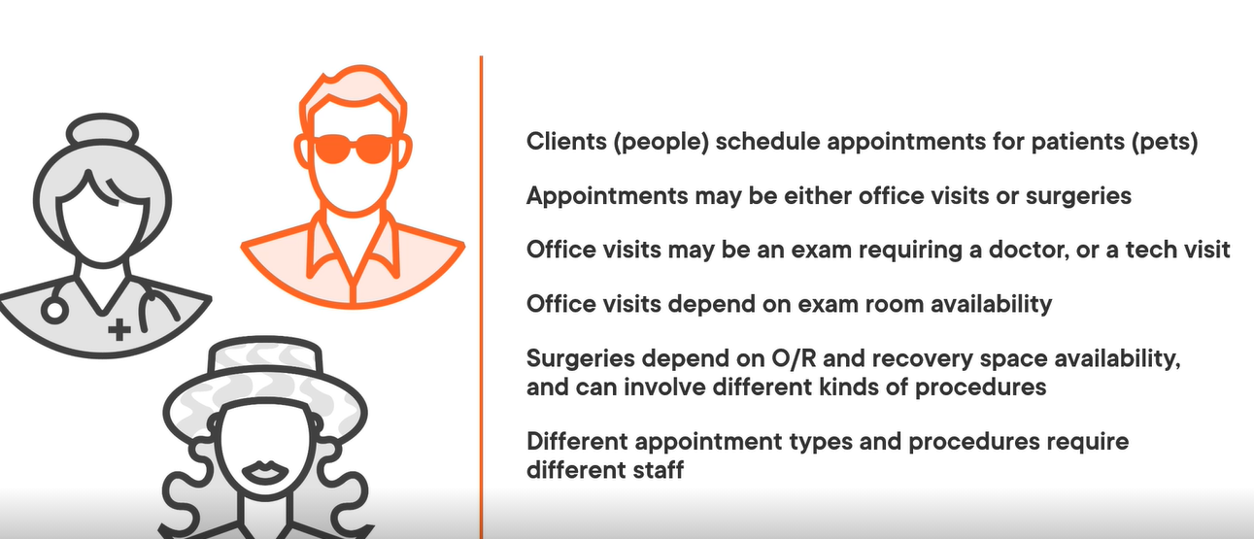
Example

Slide 33
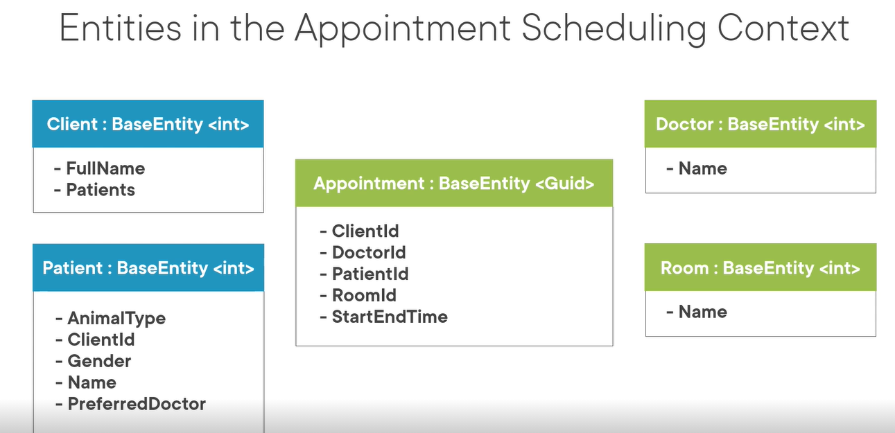
Example

Slide 34
What is Context Map In DDD?
Notes:
U- up stream context and D- is downstream context

Slide 35
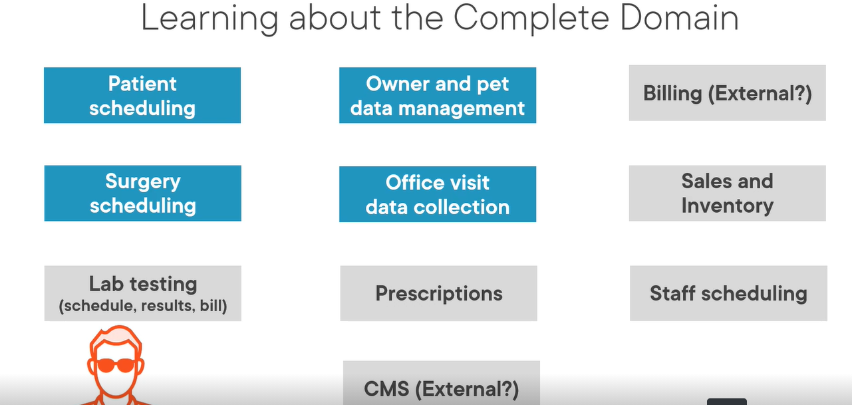
Example

Slide 36
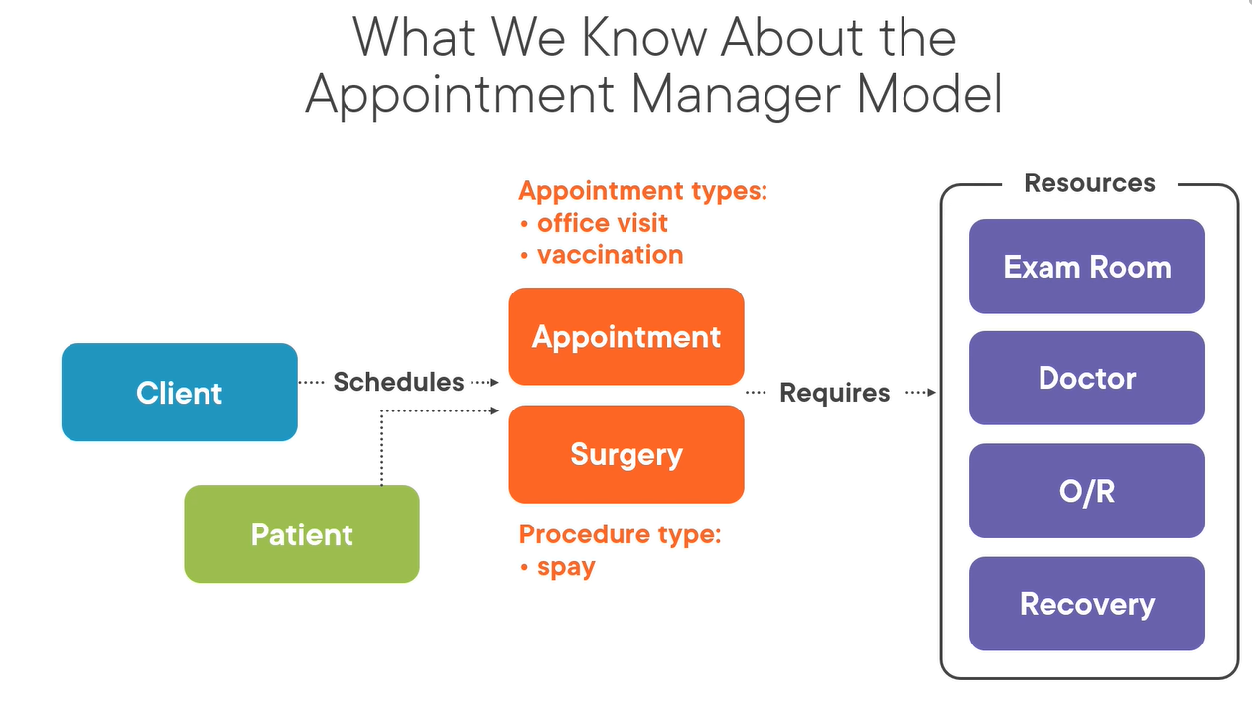
Example

Slide 37
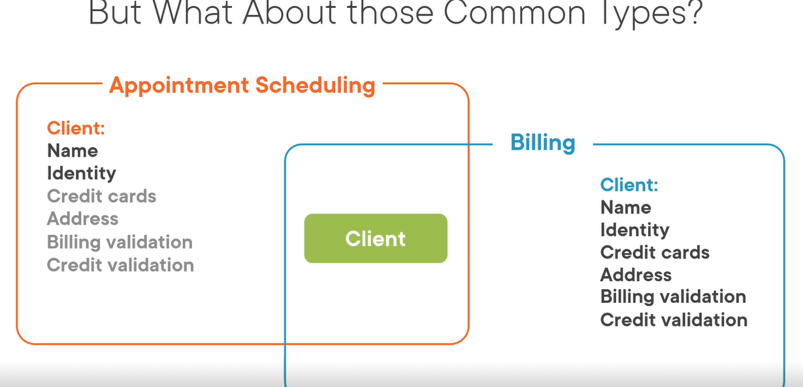
Using Bounded Context

Slide 38
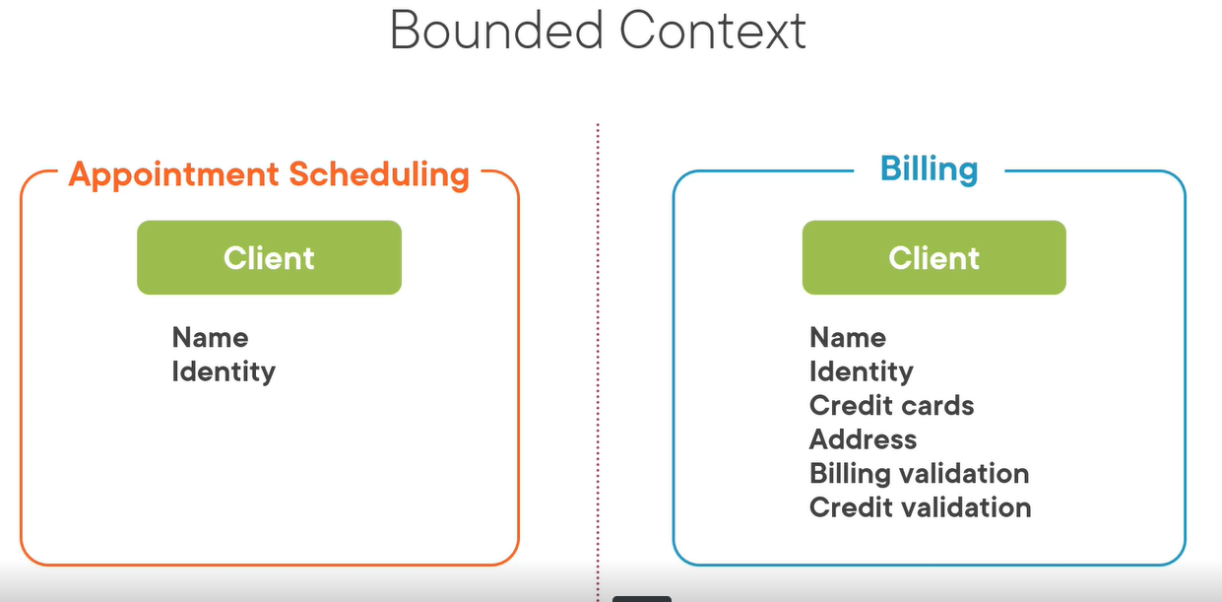
Using Bounded Context

Slide 39
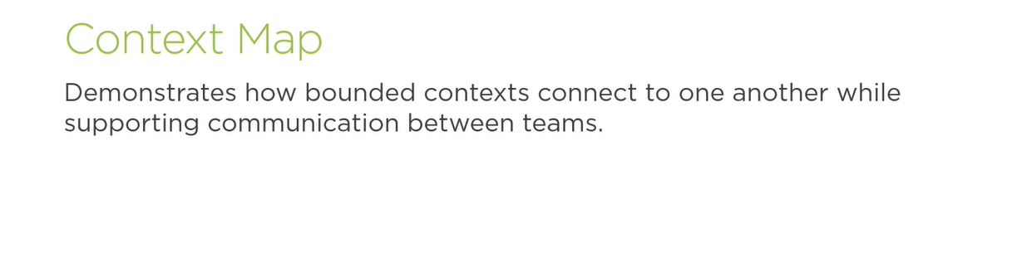
Context Map

Slide 40
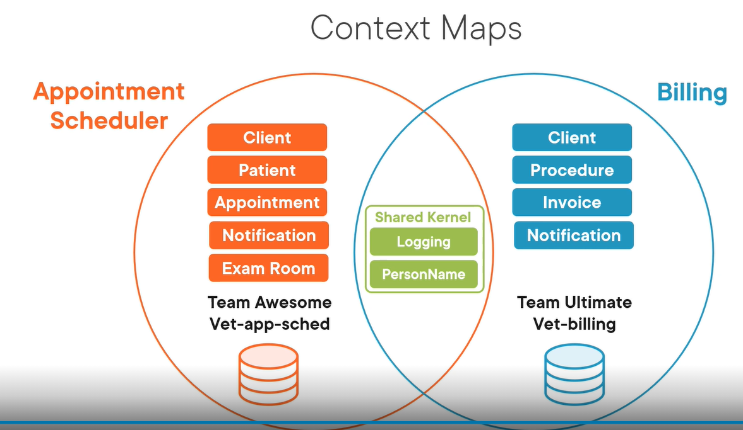
Context Map

Slide 41
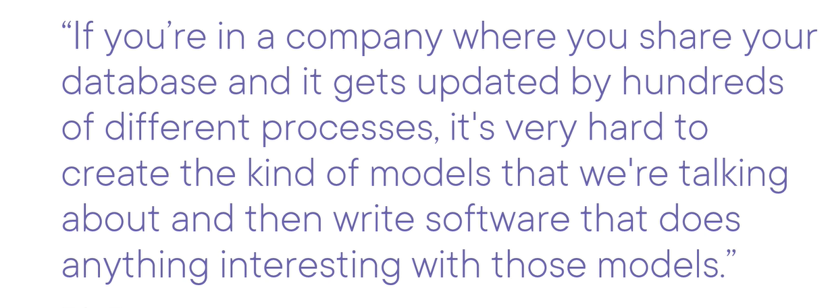
Database

Slide 42
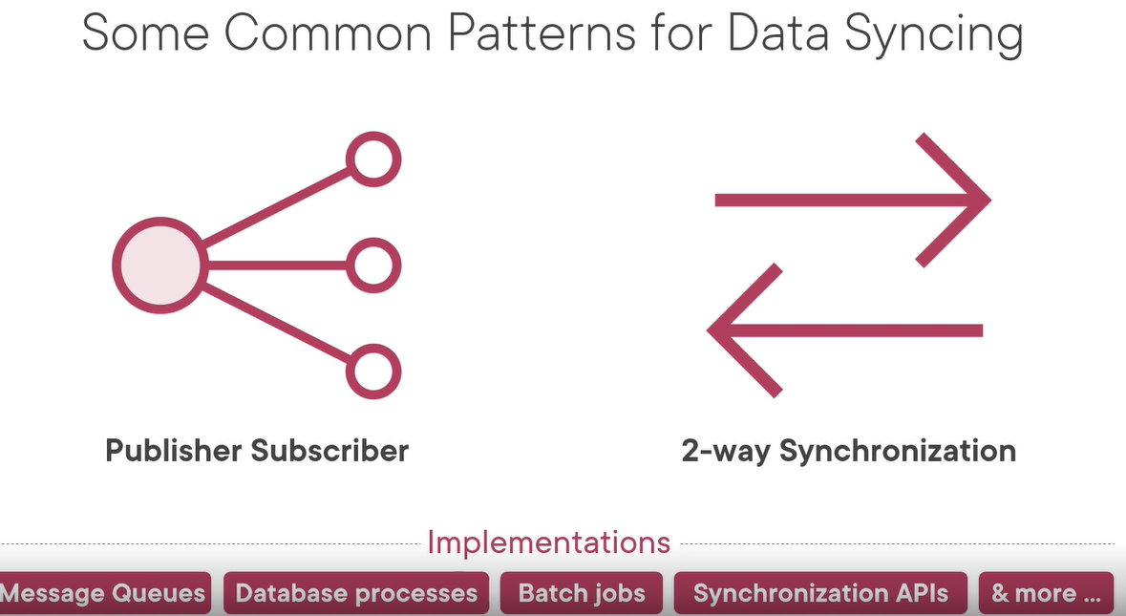
Database

Slide 43
What is Event Storming?
Notes:
RFC-Request for change

Slide 44
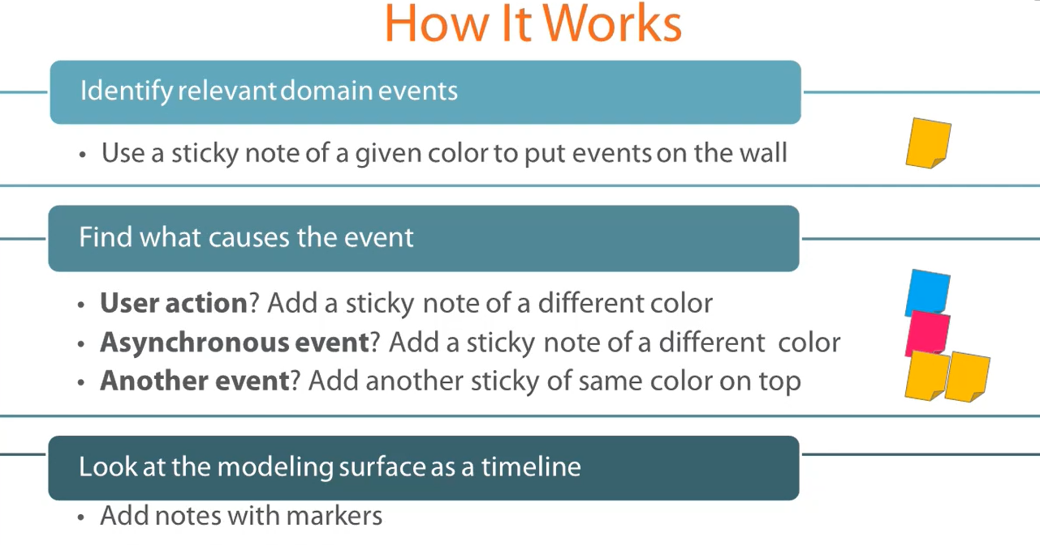
How Event Storming Works?
Notes:
RFC-Request for change

Slide 45
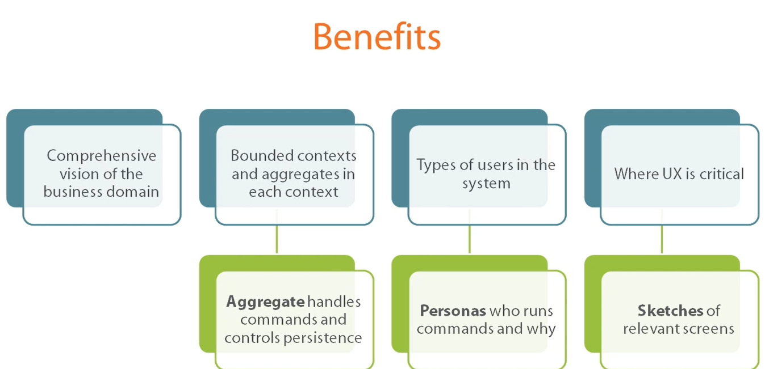
Benefits Of Event Storming
Notes:
RFC-Request for change

Slide 46
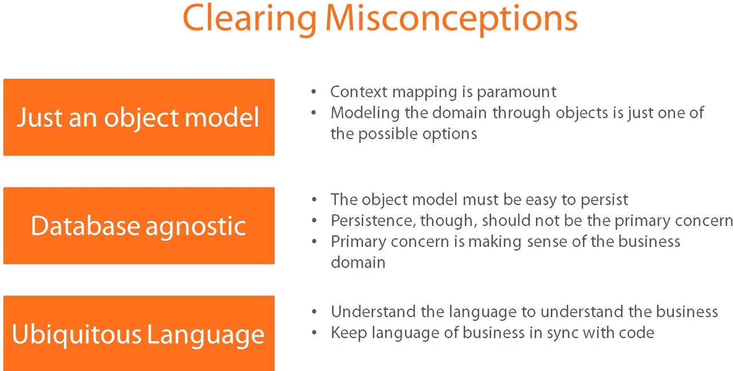
Notes:
RFC-Request for change

Slide 47
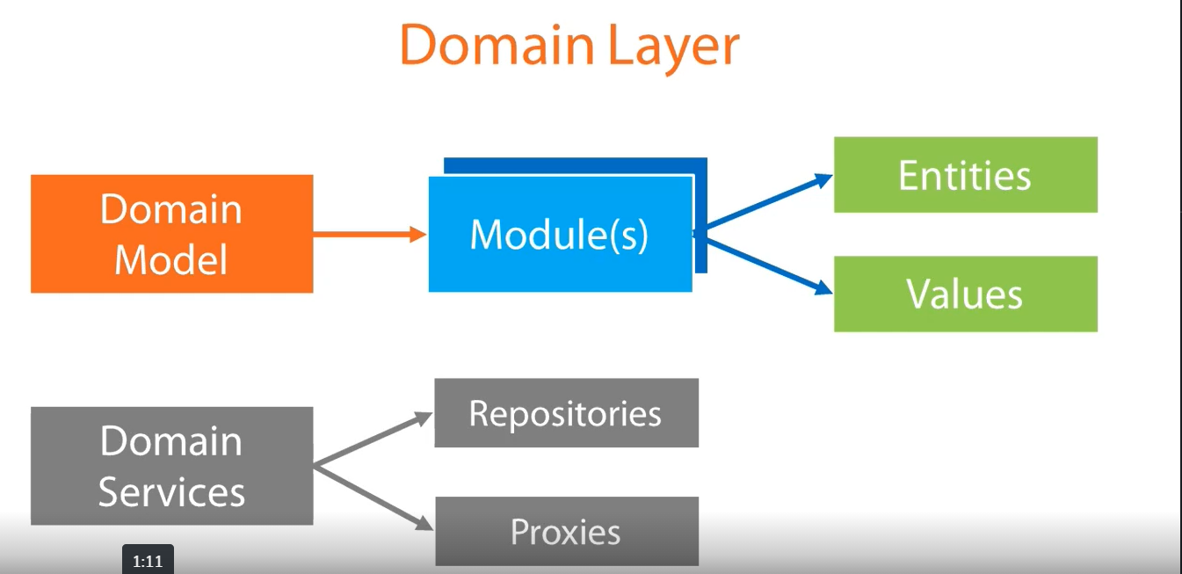
Notes:
RFC-Request for change

Slide 48
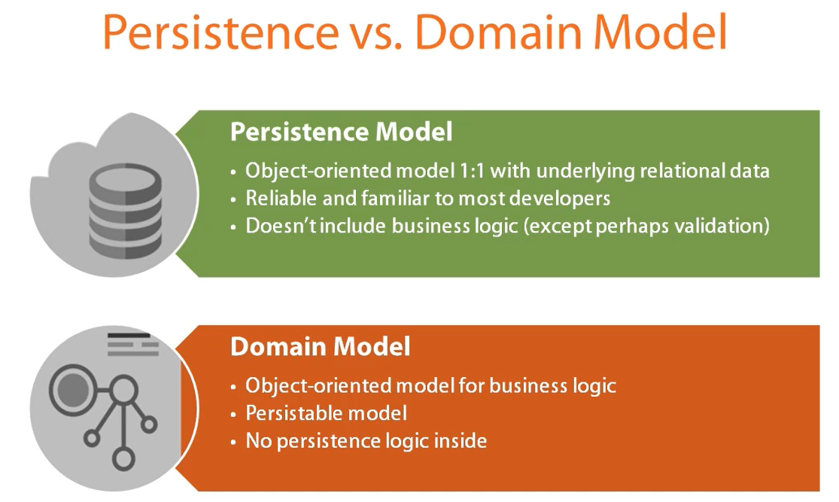
Notes:
RFC-Request for change

Slide 49
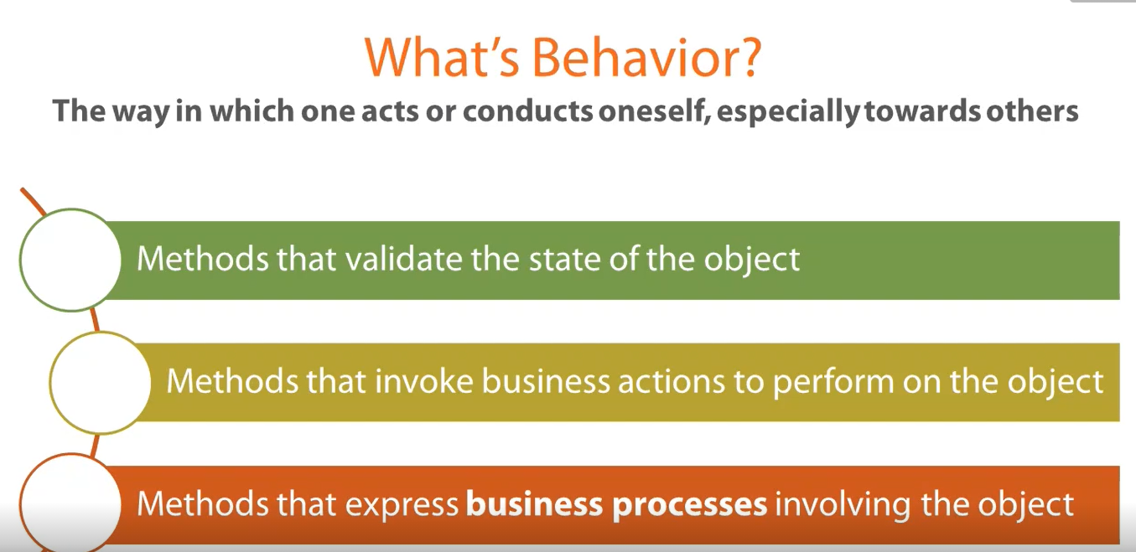
Notes:
RFC-Request for change

Slide 50
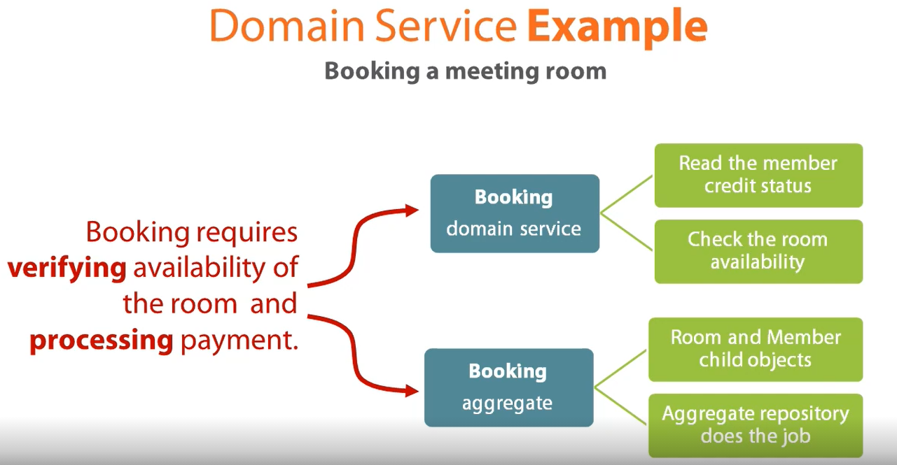
Notes:
RFC-Request for change

Slide 51
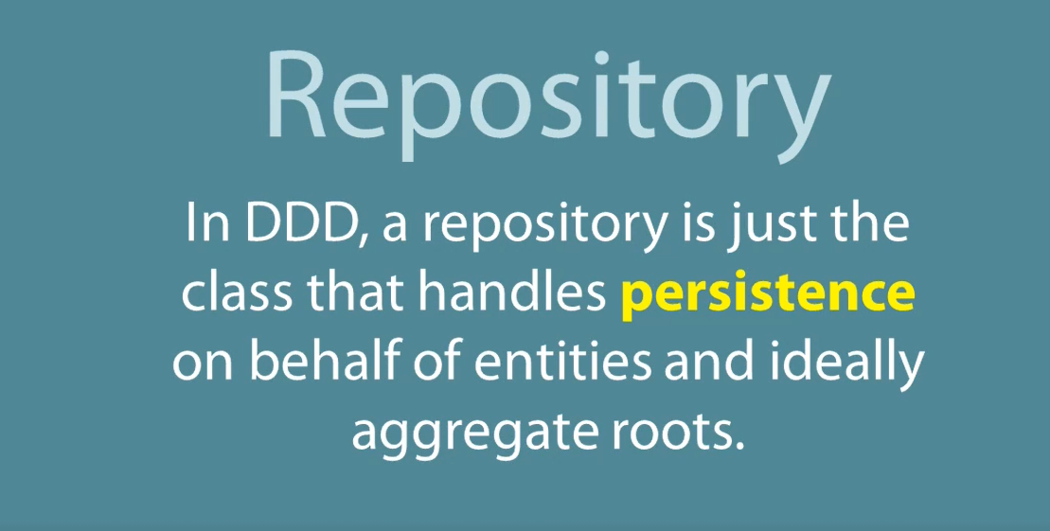
Notes:
RFC-Request for change

Slide 52
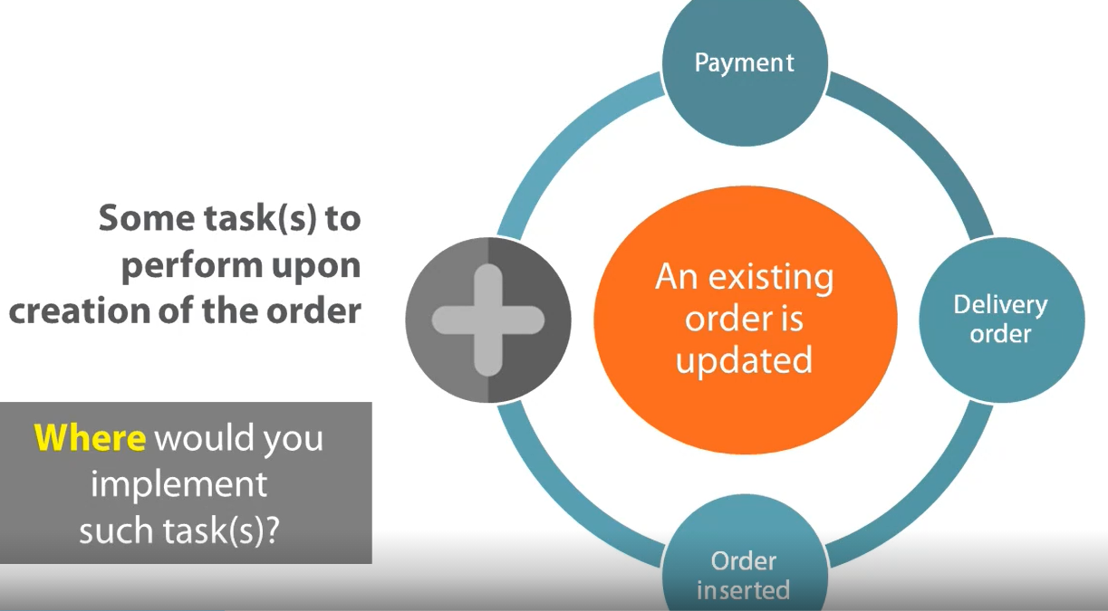
Events In The Business Domain
Notes:
RFC-Request for change

Slide 53
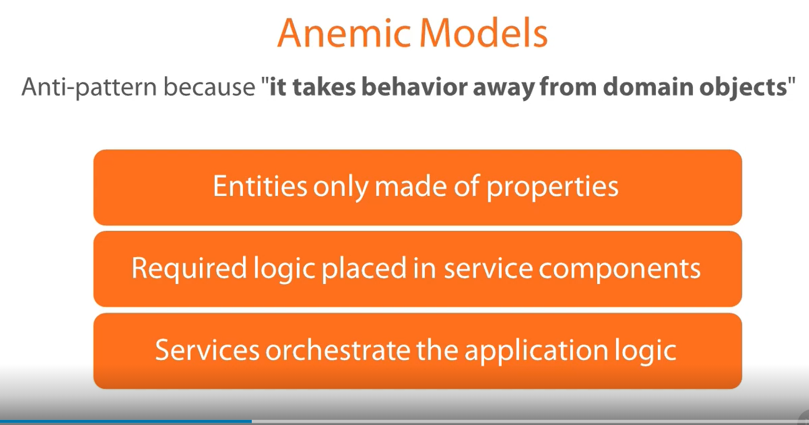
Domain Driven Design
Notes:
RFC-Request for change

Slide 54
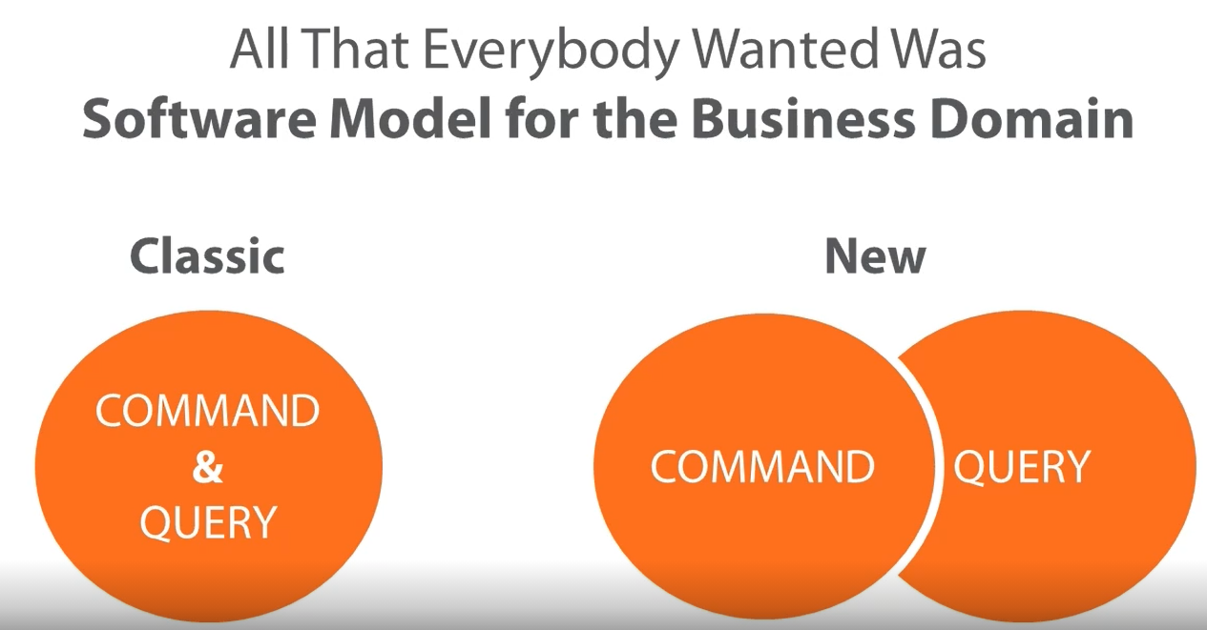
CQRS- Command Query Responsibility Segregation
Notes:
RFC-Request for change

Slide 55

Why CQRS? Following are limitation of conventional model
Notes:
RFC-Request for change

Slide 56

CQRS
Notes:
RFC-Request for change

Slide 57

Notes:
RFC-Request for change

Slide 58

CQRS
Notes:
RFC-Request for change

Slide 59

CQRS
Notes:
RFC-Request for change

Slide 60

CQRS
Notes:
RFC-Request for change

Slide 61

CQRS
Notes:
RFC-Request for change

Slide 62

CQRS
Notes:
RFC-Request for change

Slide 63

CQRS
Notes:
RFC-Request for change

Slide 64

CQRS
Notes:
Use Fasad pattern Here

Slide 65

CQRS
Notes:
Spring Example

Slide 66

CQRS
Notes:
We're going to evolve an existing REST Spring API and make it use Command Query Responsibility Segregation – CQRS.
The goal is to clearly separate both the service and the controller layers to deal with Reads – Queries and Writes – Commands coming into the system separately.

Slide 67

CQRS
You can create 2 different controller that is UserQueryRestController and UserCommanmdRestController to inject both the services. And we can even creates eparate DTO for Each
Notes:
RFC-Request for change

Slide 68

CQRS
Notes:
CQRS is a way to structure your REST APIs so that Statefull business logic can be captured as a sequence of events.

